Slide 1



Economic Activities – Portugal
Edgar Tomé
JUN, 10th | PARIS
DAFT MAY2022

Slide 2


Business case
Domain
Economic development indicators of Portugal
Problem
Compare the difference of production activities, efficiency and return for all industries, and verify witch is more important for the economy in Portugal, and how is the balance od export/import and is importance for the growth of economy.
Notes:
Compare the difference of production activities, efficiency and return for all industries

Slide 3
Plan
Select a source that was able to provide information and reliable data, for the different factors of the economy in Portugal.
Retrieve the data to prepare a data set for future analyse of the business case.
Understanding of the data collected, data cleaning of missing values our not reelevate values, primary analyses using graphic visualizations, creations of database to able to combine various data sets to create new views for analyse.

Slide 4
About data
Data source is PORDATA, the Database of Contemporary Portugal, organized and developed by the Francisco Manuel dos Santos Foundation, was created in 2009.
The collection, compilation, systematization and dissemination of data on multiple areas of society, for Portugal and its municipalities, and for the European countries.
The reported statistics derive from official and certified sources, with data production skills in the respective areas.
Production Activities | Efficiency and Return | Internationalization
Export | Apparent labour productivity | Degree of exposure to international trade
Import | Investment rate | Export intensity
Production | Degree of production | Import penetration rate
Notes:
PRODATA

Slide 5
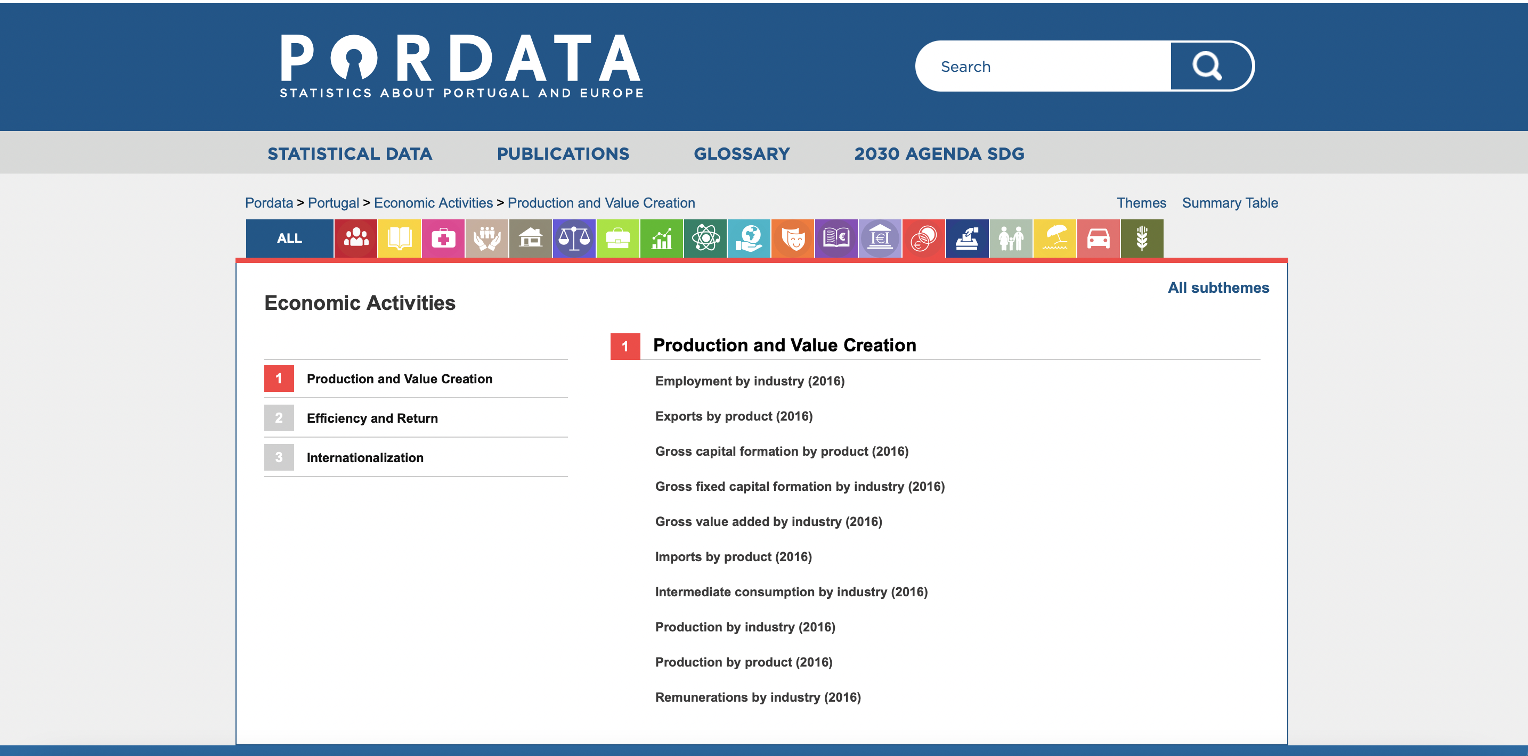
About data
Source : https://www.pordata.pt/en/Subtheme/Portugal/Production+and+Value+Creation-248

Slide 6
Meta Data
Economic Activities | Economic Activity | Geographic | Responsible entity
Exports of goods | Activity is characterized by an input of products, production process and an output of products | Portugal | INE – National institute of statists
Imports of goods
Gross value of production
Apparent labour productivity
Investment rate
Degree of production
Degree of exposure to international trade
Export intensity
Import penetration rate

Slide 7
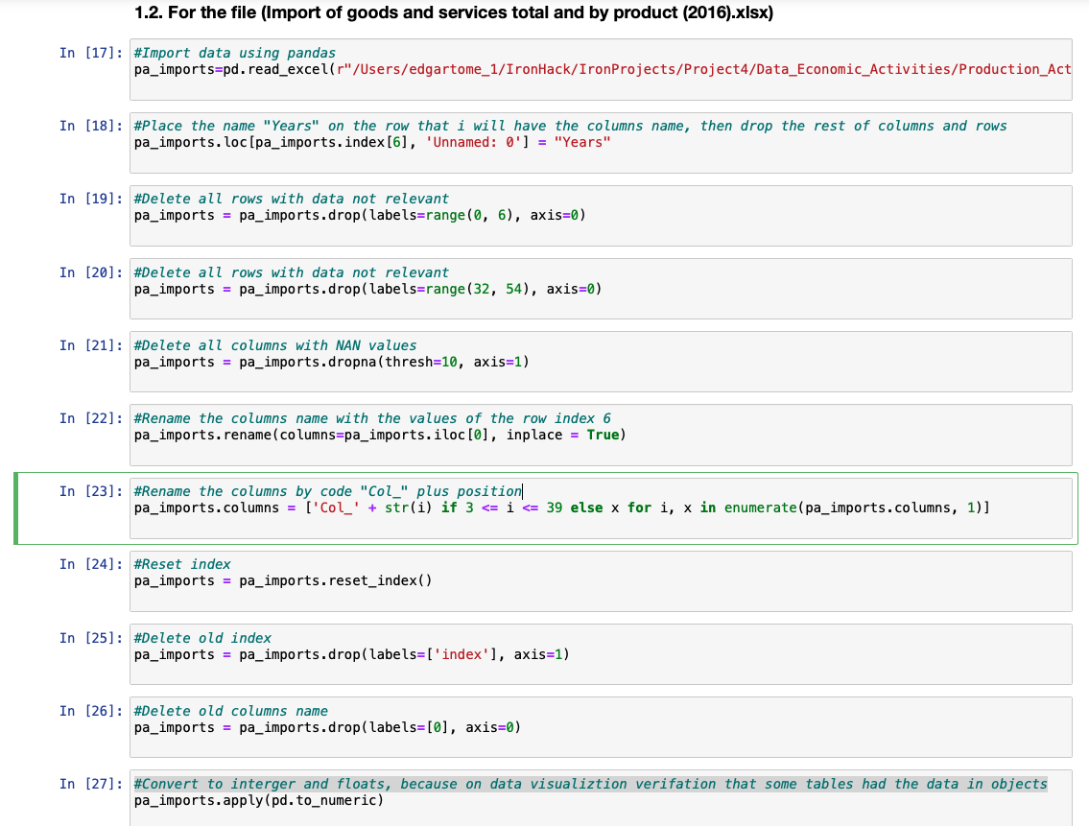
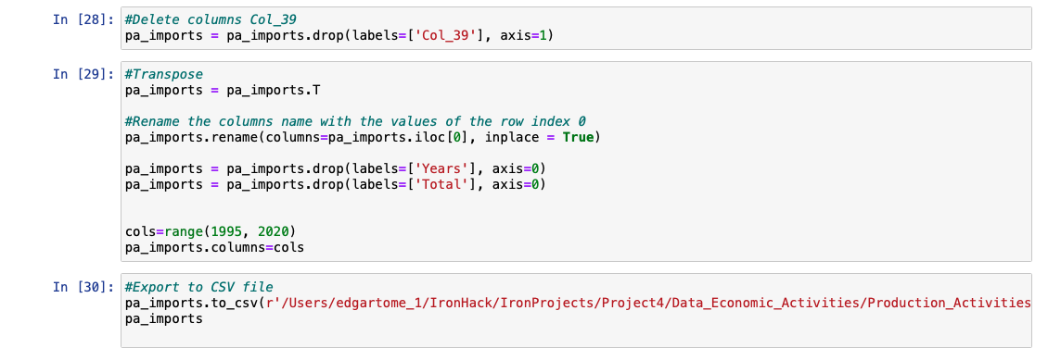
Data cleaning, data preparation
The data cleaning and exploratory data analysis process, had two different process, because the excel files didn't had the data in the same formation.
The process was in a loop, in the the first cleaning , it was deleted rows and columns with not necessary information, defined the name of columns, uniformized the data types.
Notes:
Import of the libraries Pandas and Numpy;
Import files with pandas to read Excel files;
Listed the name of the columns to verifier;
Place the name Years, in the same row as was the correct names of the columns;
Delete rows with not relevant data, and non-values, and delete columns with not relevant data, and non-values;
Rename the columns with the information on the row “6”, and print the data frame to verified the status of the data;
As the names of the industries are long length, placed encoding to the columns;
Placed new index to have order, as with the remove of rows the index add no order, and removed the old index, and the old columns name;
Exported the files to csv, to perform visualizations, noticing that was some values with category of object, had to convert to integer and floats.
Exported the files to csv, to perform visualizations, noticing that was some columns of industries that were no common to every file and category of study. Had to delete the row Col_39, as the industries was no common to the different groups, and for that reason, not comparable;
Exported the files to csv, and uploaded on database with the entity relationship model as base, verified, that a new clean had to be performed to the files, to have them suitable for the creation of data base;
Had to transform the data frame, so performed a transpose function, to convert e columns names in to index. Rename the columns names with the values of the row of Years, and remove the rows of Years and Total, then replace the columns names with range from 1995 to 2020, as the years were in float, and had to convert in integer from the year 1995 to 1999;
Exported the file into csv with pandas, to be used on database;

Slide 8
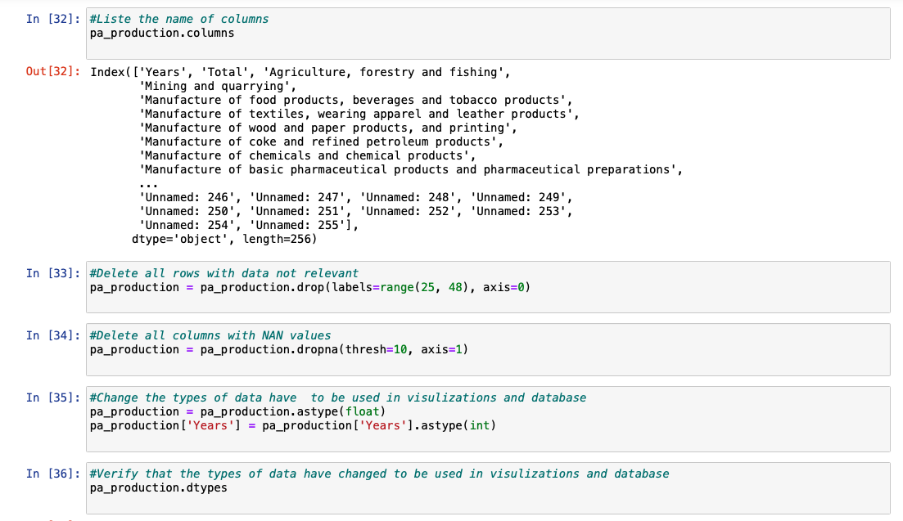
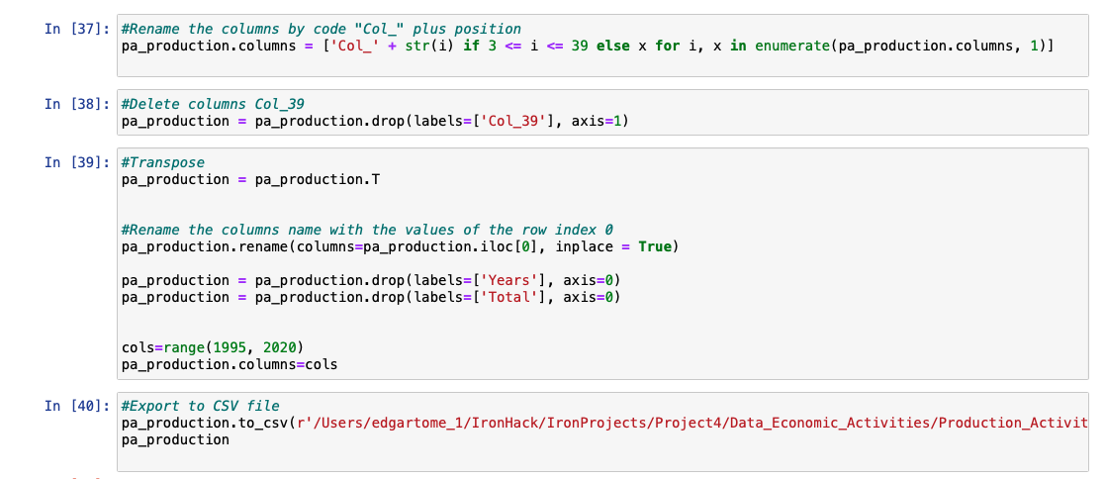
Data cleaning, data preparation
In the second iteration of cleaning after the data visualization was verified the necessity to remove more irrelevant information.
In the third iteration, after first creation of the database, realized that had to transpose the data frame to be stubble to the entity relationship model and to able to combine various data sets.
Notes:
For the rest of the files retrieved, the process of cleaning and preparation of CSV files to export to visualization and database, was the follow.
On the excel files, delete rows and columns with nan values, or with legend information on the excel formation, not relevant for the analysis that was to be performed, and moved the columns name to the first row. This was performed different from the first two files, because, during the first process of data cleaning, the python was unable to convert all the object types in to numeric values, like float our integer.
Import files with pandas to read Excel files;
Listed the name of the columns to verifier;
Delete rows with not relevant data, and non-values, and delete columns with not relevant data, and non-values;
To perform visualizations, noticing that was some values with category of object, had to convert to integer and floats, and verified that had changed;
As the names of the industries are long length, placed encoding to the columns;
Exported the files to csv, to perform visualizations, noticing that was some columns of industries that were no common to every file and category of study. Had to delete the row Col_39, as the industries was no common to the different groups, and for that reason, not comparable;
Exported the files to csv, and uploaded on database with the entity relationship model as base, verified, that a new clean had to be performed to the files, to have them suitable for the creation of data base;
Had to transform the data frame, so performed a transpose function, to convert e columns names in to index. Rename the columns names with the values of the row of Years, and remove the rows of Years and Total, then replace the columns names with range from 1995 to 2020, as the years were in float, and had to convert in integer from the year 1995 to 1999;
Exported the file into csv with pandas, to be used on database

Slide 9
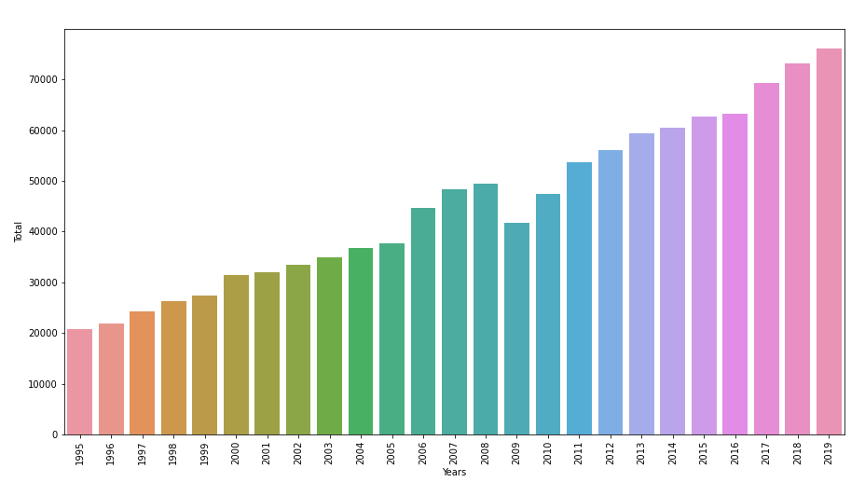
Exploratory Data Analyses
It was applied the function to obtain bars plot for the evolution true the years for production activities exports, because of the relevance of exporting as to the economy in Portugal.
Notes:
Bars plot production activities exports Portugal
During the process of data cleaning, was performed at the same time data visualization, in python with the libraries matplotlib and seaborn.
To analyse if the data was clean, and the relations between the values were corrected, and if was need to removed outliers our columns and rows with no relevance to the study.
This process was performed to all files, extracted during the loop process in data cleaning, with same visualizations and plots for each file.

Slide 10
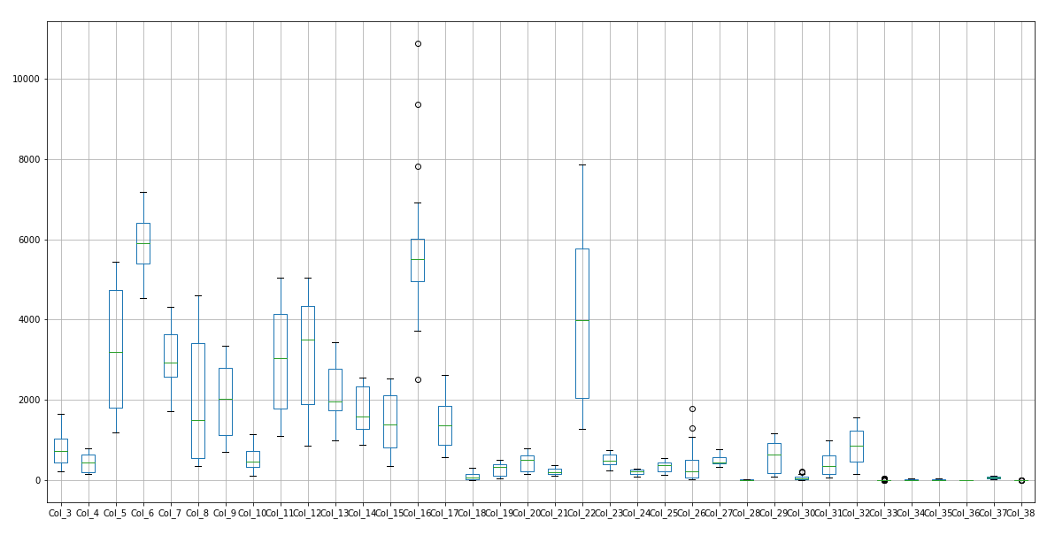
Exploratory Data Analyses
To verifier if existed outliers, was used a function of box plot, for visualization of the distribution of the values for all the industries.
Notes:
Boxplot production activities exports
It was identified outliers in the industries Col_16 (Transport equipment), that was verified has a growth on that industry in the past years, doubling the value in five years.

Slide 11
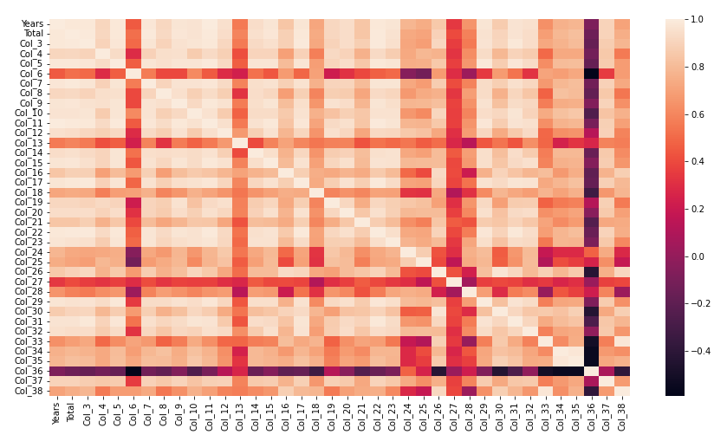
Exploratory Data Analyses
To be verified the relation between the industries in production activities exports, was applied the function correlation of numeric values and plotted using the function of heatmap.
Notes:
Correlation heatmap production activities exports
Verifying that the industries Col_23 (Accommodation and food services), have higher correlation to the industries Col_3 (Products of agriculture, forestry and fishing) and Col_5(Food products, beverages and tobacco products), the increased industries of tourism makes that the industries that provides food, beverage increases with the consumption of the tourists in the accommodations and in bars and restaurants.

Slide 12
Choose a data base
SQL – relation database | Non SQL – document oriented
The relational databases (SQL based), collects data in tables like csv files, each row in a table represents a record, production of queries that relates information in different tables. | The NoSQL databases there is no common structured schema for all records, most of the databases contain JSON records, and different records can include different fields.
In order to store the data collected in a database, that can produce queries and retrieve information with relations our not, is necessary to choose the database that is more suitable for the project
Notes:
SQL - It this structed database can be proceeded relations between rows, production of queries that relates information in different tables, but that have a relation key that are common in the tables for correlation. For that reason, before insertion of data, is need to produce the entity relationship model.
NON SQL - document-oriented the schema can vary between different documents and contain different fields, as the records are not depended it supports parallel computations. Columnar database, the data is store column by column, that makes column-based queries very efficient. Key-value database, is based on key only, requesting for a key and getting its value, not supporting queries across different record values.

Slide 13
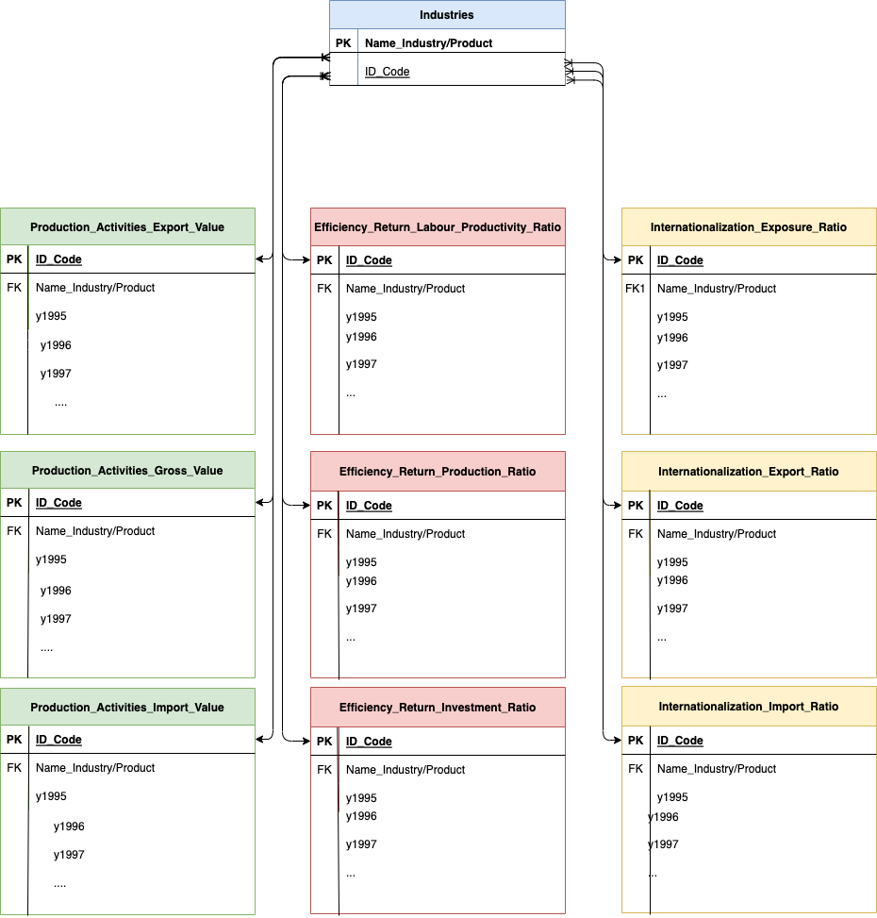
ERD
Considering the data collected and relations between industries that are of great value for analyses, it was chooses the relation data base in SQL.
For the use of relations database is necessary, before upload the data into SQL, create entity relationship model, with the different entities, and their relations, primary keys and foreign keys.

Slide 14
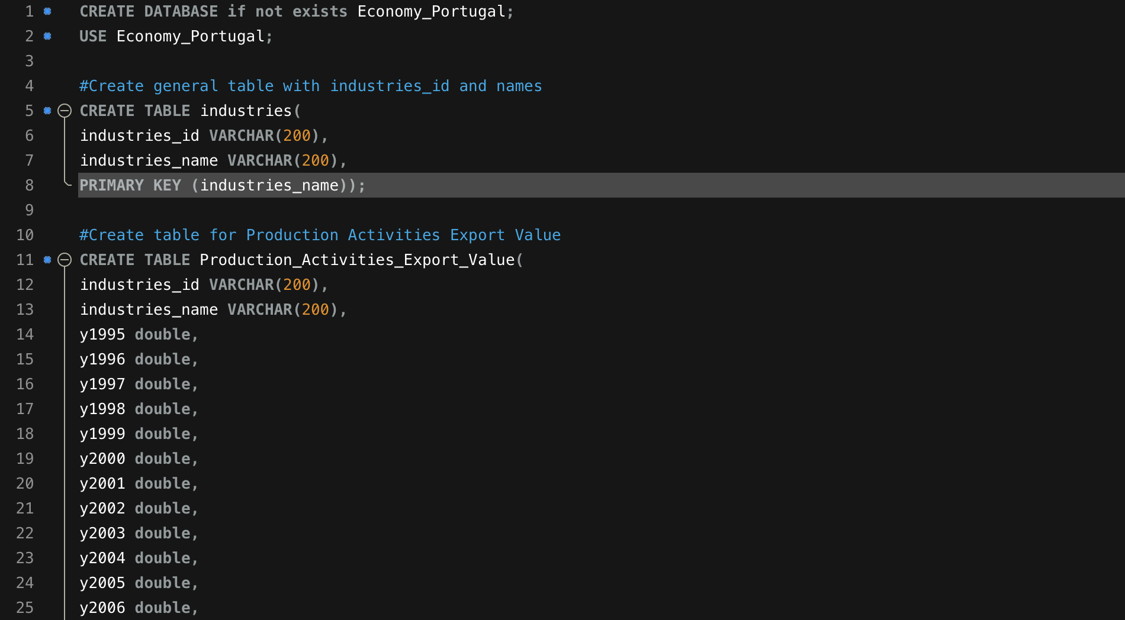
Database creation
For the project considering the data collected and relations between industries that are of great value for analyses, it was chosen the relation data base in SQL.
Create the database
Create tables with primary key and foreign key
Notes:
Query 1 - Production value comparison for import and export for the year 2019, for the industry with more value of export and industries with more value of import ;
Query 2 - Production value comparison for import and export for the year 2019;
Query 3 - Internationalization ratio comparison for import and export for the year 2019;
Query 4 - Efficiency ratio comparison for investment and production for the year 2019;
Query 5 - Total of production export and production import for last 5 years all years;

Slide 15
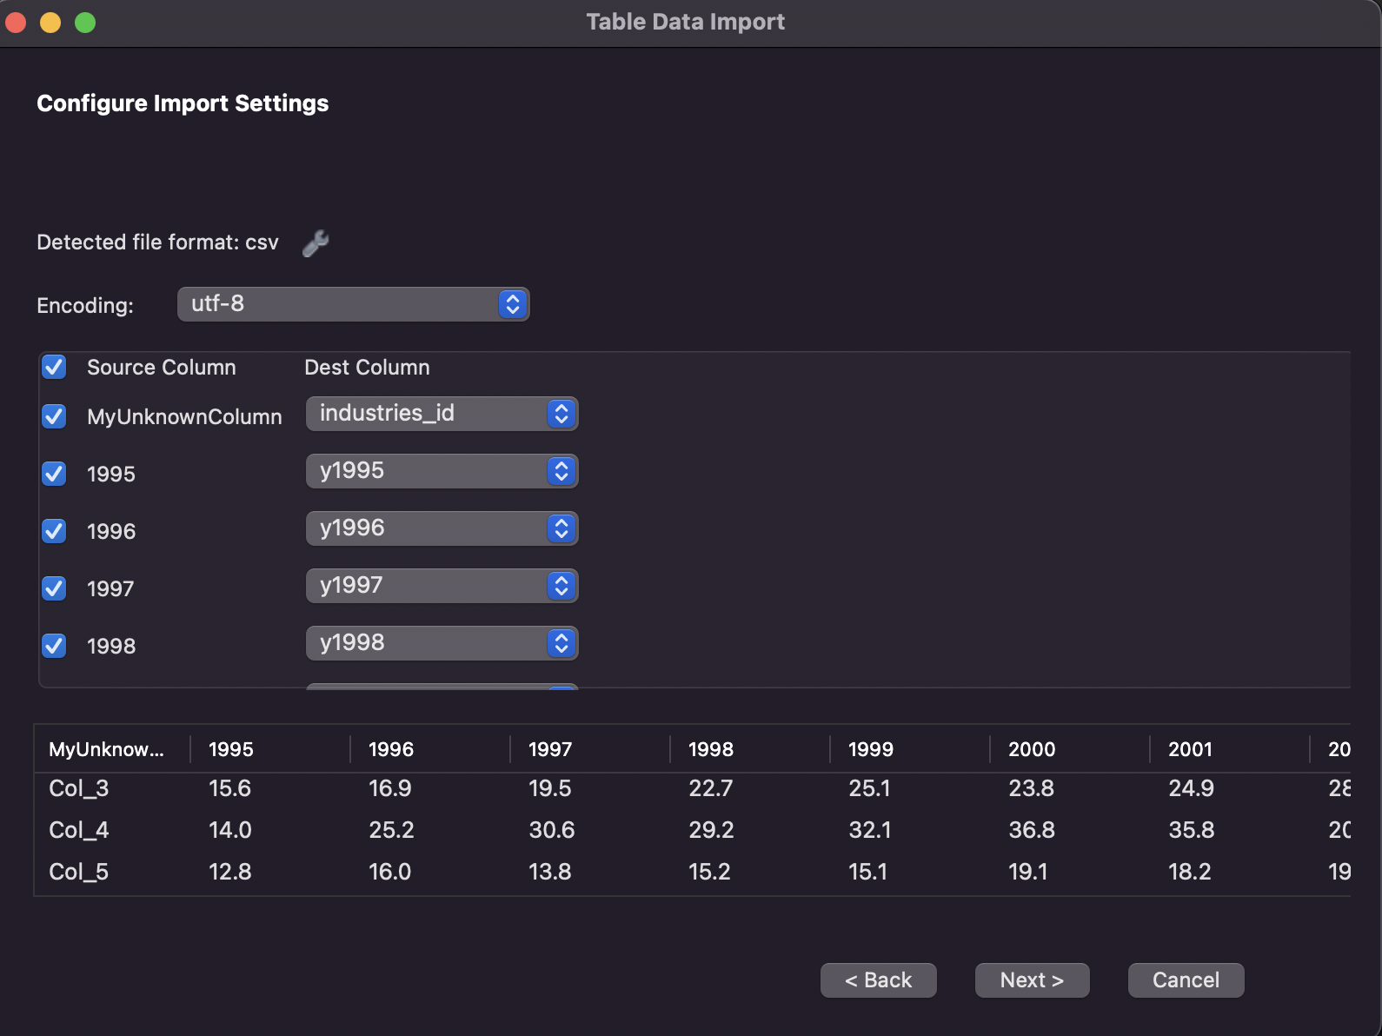
Database insertion
Import the clean data from csv files to each table
Notes:
Query 1 - Production value comparison for import and export for the year 2019, for the industry with more value of export and industries with more value of import ;
Query 2 - Production value comparison for import and export for the year 2019;
Query 3 - Internationalization ratio comparison for import and export for the year 2019;
Query 4 - Efficiency ratio comparison for investment and production for the year 2019;
Query 5 - Total of production export and production import for last 5 years all years;

Slide 16
Database queries
Perform queries, to obtain relations between industries in the subjects
Query 1 - Production value comparison for import and export for the year 2019, for the industry with more value of export and industries with more value of import ;
Query 2 - Production value comparison for import and export for the year 2019;
Query 3 - Internationalization ratio comparison for import and export for the year 2019;
Query 4 - Efficiency ratio comparison for investment and production for the year 2019;
Query 5 - Total of production export and production import for last 5 years all years;
Notes:
Query 1 - Production value comparison for import and export for the year 2019, for the industry with more value of export and industries with more value of import ;
Query 2 - Production value comparison for import and export for the year 2019;
Query 3 - Internationalization ratio comparison for import and export for the year 2019;
Query 4 - Efficiency ratio comparison for investment and production for the year 2019;
Query 5 - Total of production export and production import for last 5 years all years;

Slide 17
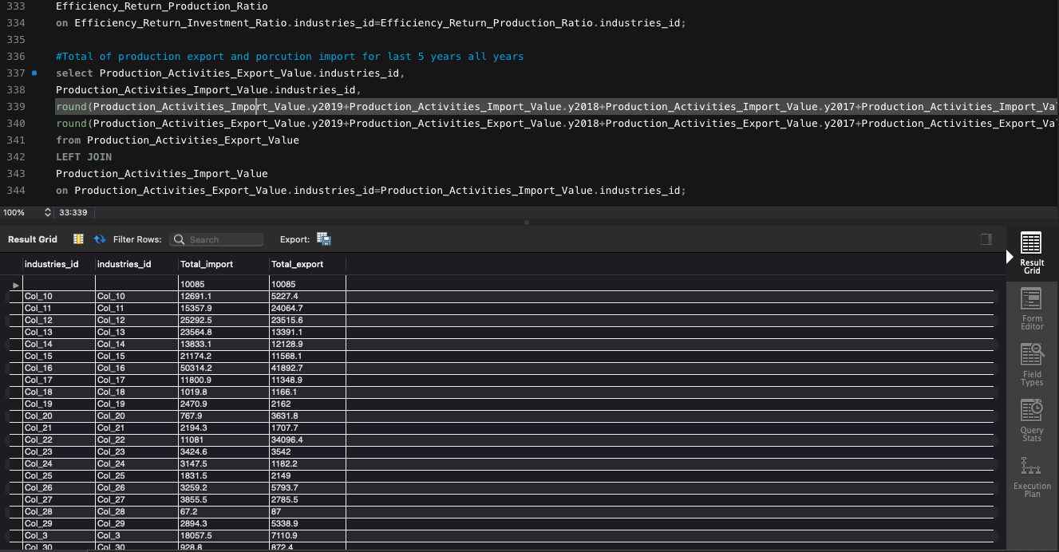
Database queries
Notes:
Query 1 - Production value comparison for import and export for the year 2019, for the industry with more value of export and industries with more value of import ;
Query 2 - Production value comparison for import and export for the year 2019;
Query 3 - Internationalization ratio comparison for import and export for the year 2019;
Query 4 - Efficiency ratio comparison for investment and production for the year 2019;
Query 5 - Total of production export and production import for last 5 years all years;

Slide 18
Conclusions
The process of collection data, cleaning data, visualization data, creation of database and retrieving queries from all the data inputted:
It is the principal base for analysed the data of the study object, giving information, that have to be contextualized with reality and whit the requirements of the project.
This process is a loop, that for each iteration, some conclusions can be made and a new perspective can be observed, and verify that new clean as to be performed.
With clean data, we have the information to perform data analyse. By defining a database to store the data, where can be made de queries of the relations between the different factors of the economy and industries, to retrieved conclusion of economic development indicators of Portugal

Slide 19
Economic Activities - Portugal
Edgar Tomé
Questions?
Merci

